Slide 1
NLP Workshop
2024

Slide 2
Fundamental Text Tasks
Translation
Summarization
Classification
Information Extraction
Notes:
There are lots of fundamental tasks in Natural Language Processing (NLP):
Translation - e.g. from French into English
Summarization - e.g. taking a long news article and producing a short summary
The simplest two (and the ones we will consider today) is:
Classification - assigning a label to a piece of text
Information extraction - a broad family of tasks where the aim is to extract knowledge in some structured form from text

Slide 3
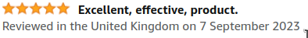


Classification
Notes:
An example of a classification task. Say we’re given loads of reviews of amazon products.
We can use machine learning to label the reviews as positive (5 star) or negative (1 star) automatically.

Slide 4

Classification
Notes:
Here’s an example that we’re going to come back to throughout today - disaster tweet classification.
During an emergency situation, organisations increasingly monitor social media to find out what’s happening on the ground. There are often lots of irrelevant tweets.

Slide 5
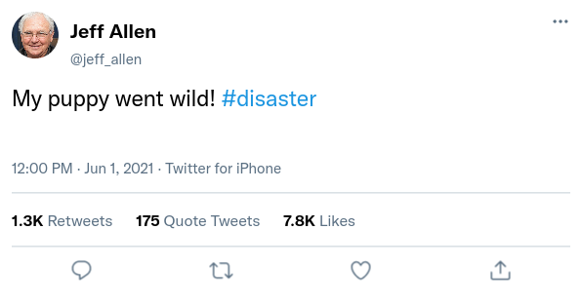


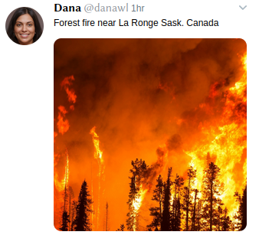
Classification
Notes:
Here are some examples. The tweets on the left are actually about natural disasters while the tweet on the right is not.

Slide 6
Classification
I have been working with Archie, a 10-year-old diabetic cat. He currently receives 3 units of ProZinc insulin
Cat vs Dog
Neutered / Spayed?
Notes:
Here’s an example from my own research. I’m working with a company that operates a forum for vets to discuss cases coming into their surgery.
We might want to analyse the cases to answer questions like “are there more dogs than cats being discussed?”
To answer this we need to label each post on the forum with whether the subject is dogs or cats.

Slide 7
Information Extraction
DISEASE
I have been working with Archie, a 10-year-old diabetic cat. He currently receives 3 units of ProZinc insulin
DOSE
DRUG
Notes:
This project also involved information extraction. Here we’re extracting all the names of diseases, symptoms, drugs, doses etc

Slide 8
Information Extraction
DISEASE
I have been working with Archie, a 10-year-old diabetic cat. He currently receives 3 units of ProZinc insulin
DOSE
DRUG
Notes:
We might also want to discover relationships. In this example we want to capture the information that the dosage “3 units” refers to this particular drug.
This allows for queries such as “give me all the posts where more than X units of Y drug is used”

Slide 9
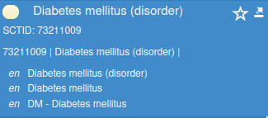
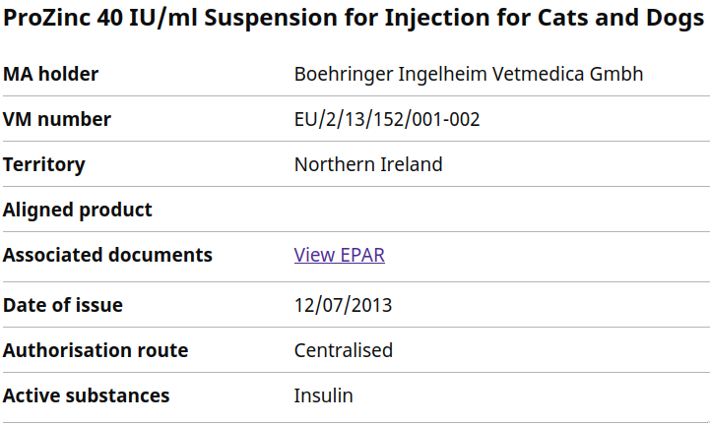
Information Extraction
DISEASE
I have been working with Archie, a 10-year-old diabetic cat. He currently receives 3 units of ProZinc insulin
DOSE
DRUG
Notes:
Finally, when writing posts, authors can refer to the same thing in different ways. Drugs have trade names, diseases can have different forms.
E.g. “diabetic cat” and “a cat with diabetes” refer to the same thing
To capture this we can link these back to databases of diseases and drugs (called entity linking)

Slide 10
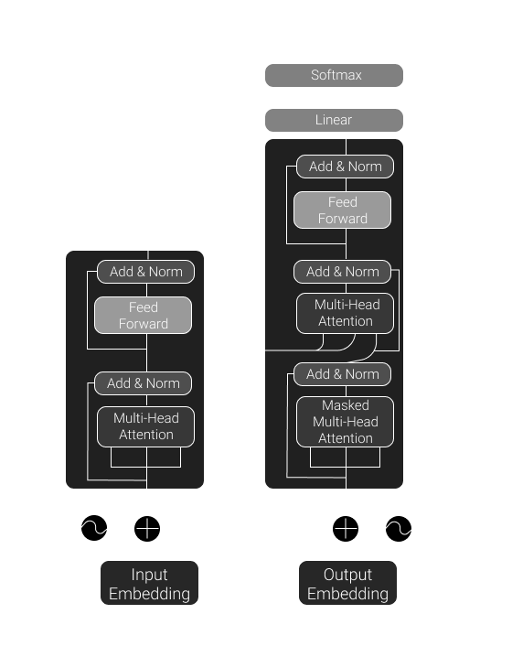
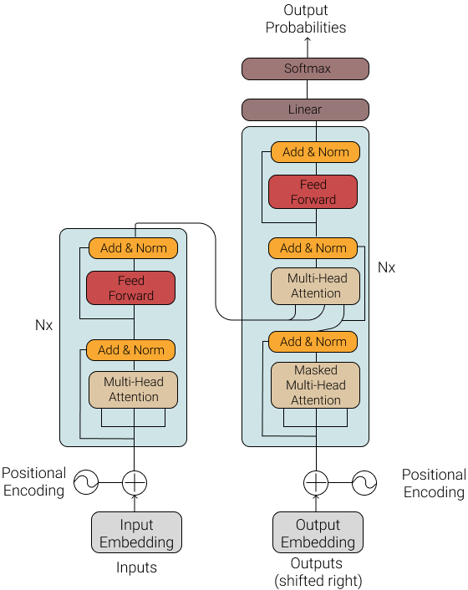
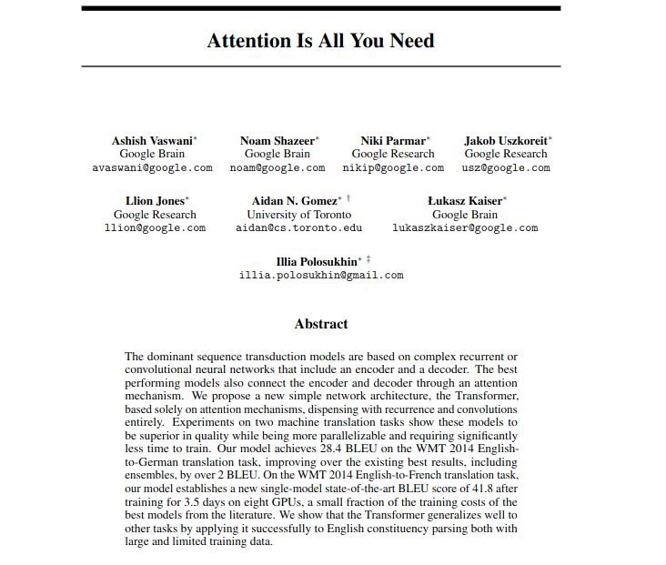
Transformers
Notes:
There’s a specific type of neural network called the transformer.
The key innovation is attention mechanism.

Slide 11
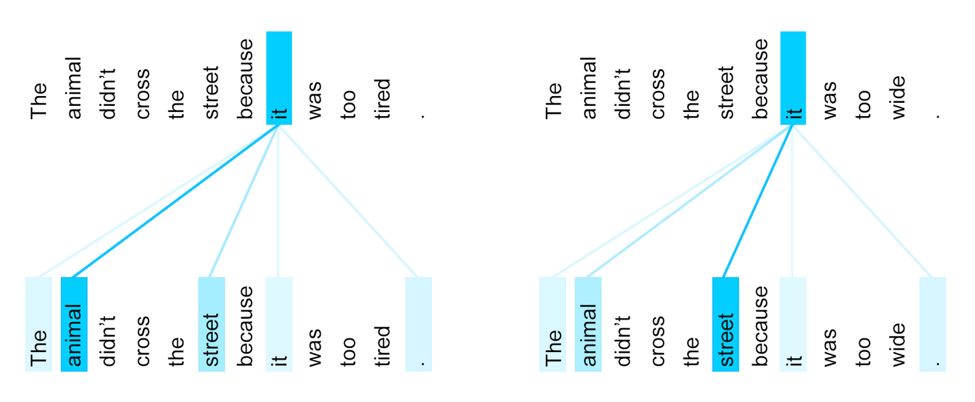
Notes:
The key innovation is attention. Attention is a way of making neural networks learn which parts of the input are important to consider when understanding other parts. For example, ‘it’ here refers to different nouns depending on the final word.

Slide 12
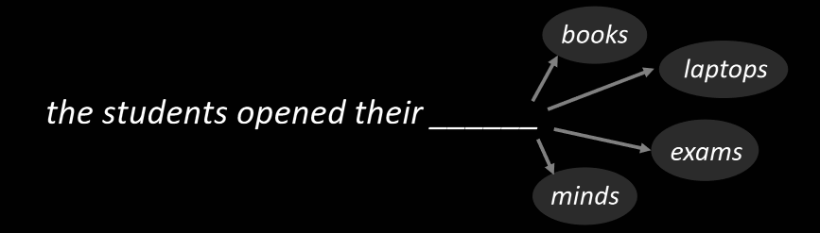
Language Models
Notes:
Language modelling is a task we can train models on which doesn’t need any training data!
It’s basically like autocorrect on your phone. Just predict what the likely next word is.
It turns out, if our model can do this really well, it must have learnt a lot about language - we can use this as a starting checkpoint for finetuning models.

Slide 13
No labels?
Notes:
While basic transformers are great at solving many problems, in the real world we rarely have access to lots of high quality labels for our task.
What do we do if we have no labels?
In the last few years a new paradigm has emerged: “prompt-based learning”. You’re probably familiar with this if you’ve ever used chatGPT: Interaction with the model is based on chatting, where you prompt the model to do something, and the model replies with the answer.
If we can describe a problem well, we should be able to construct a prompt to solve it.

Slide 14
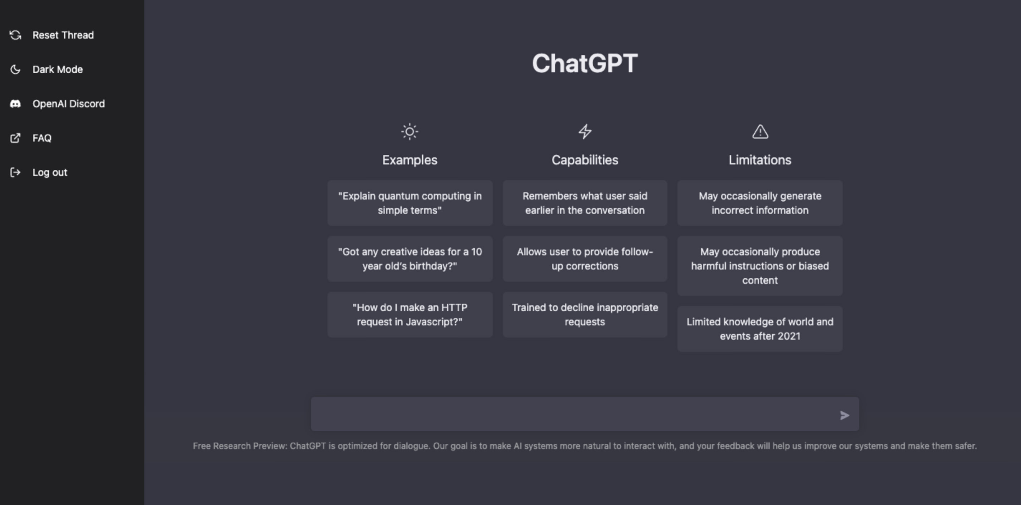
Prompting
Notes:
While basic transformers are great at solving many problems, in the real world we rarely have access to lots of high quality labels for our task.
What do we do if we have no labels?
In the last few years a new paradigm has emerged: “prompt-based learning”. You’re probably familiar with this if you’ve ever used chatGPT: Interaction with the model is based on chatting, where you prompt the model to do something, and the model replies with the answer.
If we can describe a problem well, we should be able to construct a prompt to solve it.

Slide 15
Zero-Shot Prompting
Prompt:
Classify the text as positive or negative.
Text: I think NLP is amazing.
Sentiment:
Output:
positive

Slide 16
Few-Shot Prompting
Prompt:
Classify the text as positive or negative.
Text: I hate everything.
Sentiment: negative
Text: I think the NLP is amazing.
Sentiment:
Output:
positive

Slide 17
Can we improve prompting further?
Yes
Lots of ways
www.promptingguide.ai

Slide 18
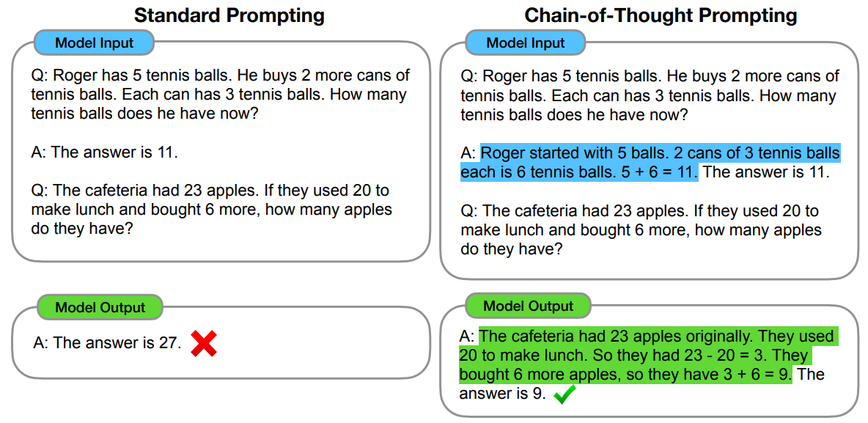
Chain of thought
Break down complex problems
Notes:
Chain of thought is a method which improves the reasoning of LLMs especially for tasks which require multiple steps. This is few-shot CoT.
It’s like asking the model to show it’s ‘working out’.
In this example we’re adding an additional step, asking the model to show the intermediate parts of the reasoning in the example. The model will then copy this format, giving the working out.

Slide 19
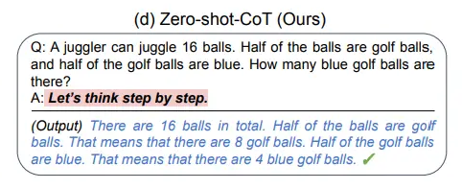
Zero-Shot Chain of Thought
Kojima et al. (2022)
Notes:
It can be quite hard sometimes to come up with a load of few-shot examples for CoT with all the intermediate steps.
Kojima et al found a bit of a cheat - if you end your prompt with “Let’s think step by step” the model will often produce the correct reasoning without any examples!

Slide 20

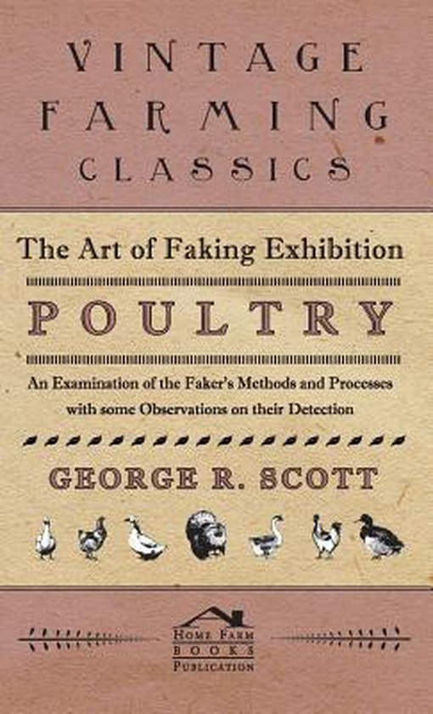
Limits of LLMs
Notes:
LLM’s are surprisingly good at a lot of tasks, especially if we apply techniques such as chain of thought.
There are some scenarios where LLMs on their own are not enough. No matter how clever the prompt we craft:
If the model needs to know something which happened after it was trained.
If the model needs to know a fact in some niche subject field

Slide 21
Retrieval Augmented Generation (RAG)
Query
Vector Database
Similar Documents
LLM
Response
Notes:
The idea of RAG is we allow LLMs to access some external source of knowledge and use them to help produce their answer.
We start off with a Query (some input to the model), we then find a small number of documents which match the query. Finally we pass the query and our retrieved documents to the LLM which uses them to produce a final answer.

Slide 22
Vector Databases
Document
Embedding Model
[0,1,0,0.455, -0.4566,...]
Notes:
So how does the vectorDB work?
Well we can turn pieces of text into numbers by using an embedding model. This model is very similar to the language model itself but instead of outputting the next word, we use the outputs from an internal layer. The model will have encoded something about the document in this vector which we can store alongside the original document.

Slide 23
Vector Databases
Document 1
[0,1,0,0.455, -0.4566,...]
Document 2
[-0.4566,0.34130, 0,4...]
Document 3
[0.34, 0.64, 0.99, 0.5,...]
…
…
Notes:
If we pass many documents into our vector DB, we can store the text alongside the embedding vector.

Slide 24
Vector Databases
Document 1
[0,1,0,0.455, -0.4566,...]
Document 2
[-0.4566,0.34130, 0,4...]
Document 3
[0.34, 0.64, 0.99, 0.5,...]
…
…
cosine similarity
Query
Embedding Model
[0,1,0,0.455, -0.4566,...]
Notes:
Now when we get a query we can use a distance measure such as cosine similarity to measure how close our query is to each document in our vector DB. We can then return the most similar documents to pass to the LLM.

Slide 25
Crafting Prompts
Art or Science?
Notes:
When you’re making prompts, it might feel like more of an art than a science, there are guidelines but little in the way of hard and fast rules.
Building applications using large language models (LLMs) is not only complex but also brittle. Typical pipelines are often implemented using prompts that are handcrafted through trial and error because LLMs are sensitive to the way prompts are used. Therefore, when you change a part of the pipeline (such as the LLM or the data), you may weaken its performance - unless you adjust the prompts (or fine-tune the steps).

Slide 26
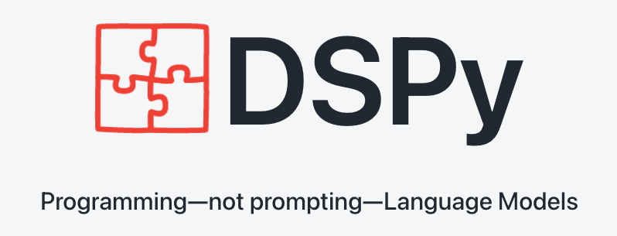
Notes:
DSPy a framework that aims to solve the brittleness problem in language model (LM)-based applications by prioritizing programming over prompts. It allows you to recompile the entire pipeline when you change a component to optimize it for your specific task, rather than repeating manual rounds of prompt engineering.

Slide 27
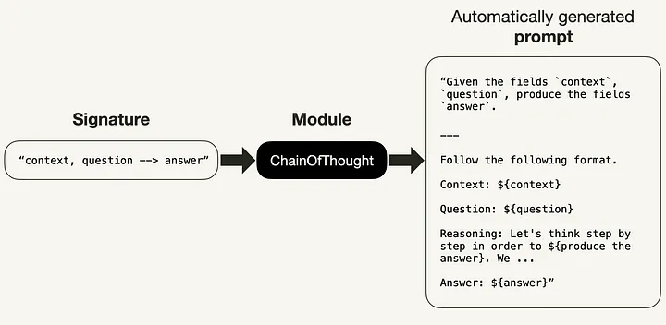
Notes:
DSPy introduces the following series of concepts:
Handwritten prompts and fine-tunes are abstracted and replaced with Signatures
More advanced prompting techniques, such as Chain of Thought, are abstracted and replaced with Modules.
Manual prompting is automated by teleprompters and the DSPy compiler

Slide 28
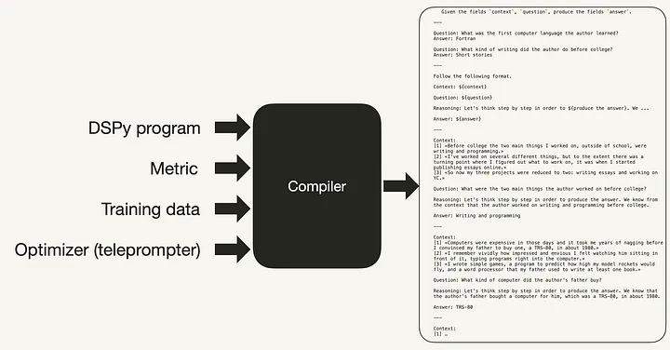

Slide 29
